Slide 1
ALTERA
MICROPROCESSOR GROUP PRESENTATION

Slide 2
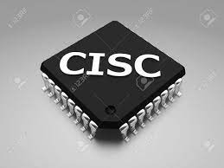
DESIGN OF A 16-BIT CISC CPU

Slide 3
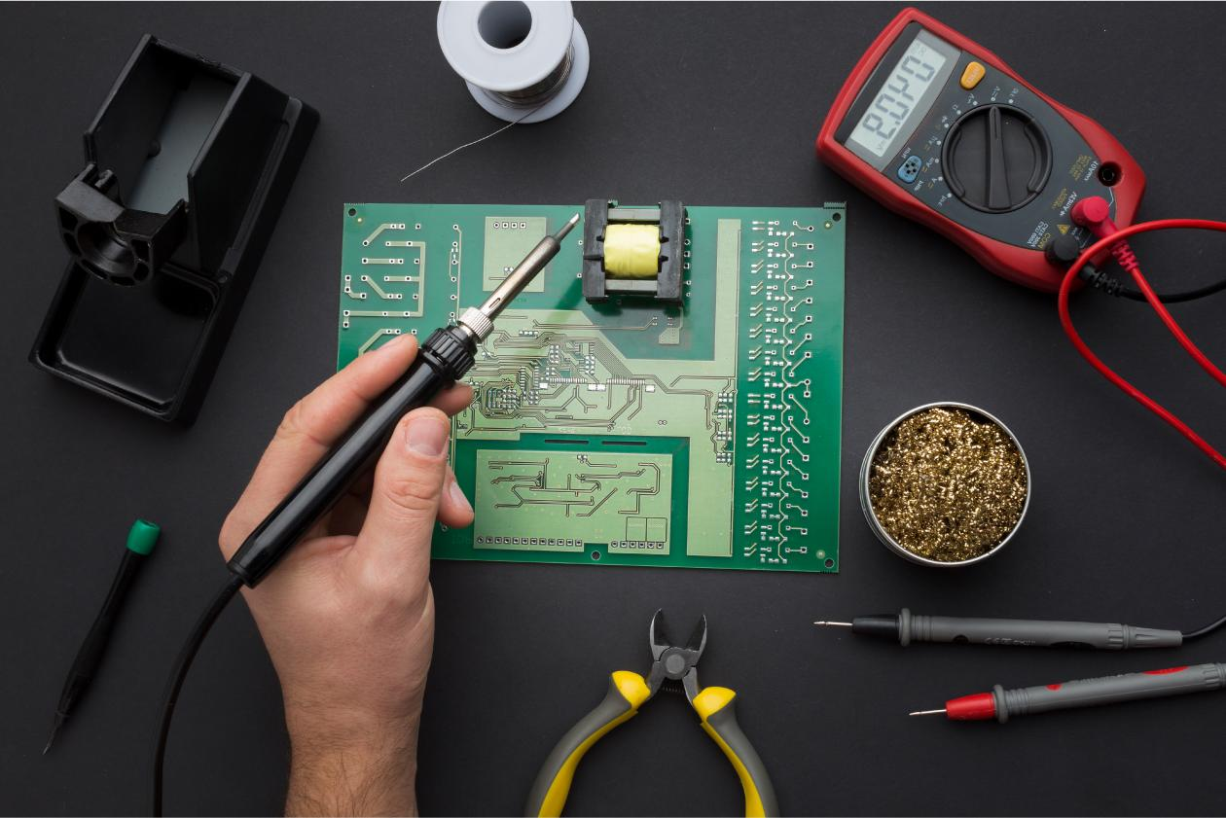
ARCHITECTURE
CISC – Complex Instruction Set Computer
Von Neumann Architecture

Slide 4
IMPLEMENTATION OF DESIGN
ALU
Control Unit
General Purpose Registers
CPU

Slide 5
INSTRUCTION FORMAT
For R-type : Arithmetic, Logic
R-operation - 3 registers no immediate
For I- type : Load/Store, immediate
I - operation - 1 register and immediate
NB: Store 2 : 2 registers and RT contains the address
For J-type (targeted address) : jump
J - operation - 0 registers and address

Slide 6
INSTRUCTION FORMAT
ALU
Opcode | Source 1 | Source 2 | Destination
0000 | 0000 | 0000 | 0000
MOVR
Opcode | Target | Source | Don’t care
0000 | 0000 | 0000 | XXXX
MOVI
Opcode | Target | Immediate
0000 | 0000 | 0000 00000
LOAD
Opcode | Target | Address
0000 | 0000 | 0000 00000
STORE1
Opcode | Target | Address
0000 | 0000 | 0000 00000

Slide 7
STORE2
Opcode | Source1 | Source2(always 0000) | Address(Destination)
0000 | 0000 | 0000 | 0000
JMP
Opcode | Don’t care | Address
0000 | XXXX | 0000 00000
JMPZ
Opcode | Don’t care | Address
0000 | XXXX | 0000 00000
JMPN
Opcode | Don’t care | Address
0000 | XXXX | 0000 00000

Slide 8
Instructions
Instruction Set Architecture
Extended Instruction Set Architecture
ADD
SUB
MULT
DIV
SHL
SHR
AND
OR
MOVR
MOVI
LOAD
STORE
JMP
JMPZ
JMPN
NOP/HALT
ADDC
EXCHANGE

Slide 9
INSTRUCTION SET
OPCODE | INSTRUCTION | MEANING
0000 | ADD | Addition Operation
0001 | SUB | Subtraction Operation
0010 | MULT | Multiplication Operation
0011 | DIV | Division Operation
0100 | SHL | Shift Left
0101 | SHR | Shift Right
0110 | AND | AND Operation
0111 | OR | OR Operation

Slide 10
INSTRUCTION SET
OPCODE | INSTRUCTION | MEANING
1000 | MOVR | Move ( Register )
1001 | MOVI | Move ( Immediate )
1010 | LOAD | Read from Memory
1011 | STORE | Write to Memory
1100 | JMP | Unconditional Jump
1101 | JMPZ | Jump if zero
1110 | JMPN | Jump if negative
1111 | HALT/NOP | Stop the CPU / No operation

Slide 11
Hardware Realization
The main components that make used in our processor.

Slide 12
Components of the CPU
Registers
ALU
High speed locations for storing information
Performs arithmetic operations
1
2
3
4
5
RAM
Program Counter
Control Unit
Read from or write to on a short term basis
Holds the instructions address
Generate control signals to control the flow of information within the CPU

Slide 13
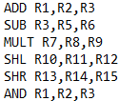
THE ASSEMBLER
The Assembler converts our assembly to machine code for the processor

Slide 14
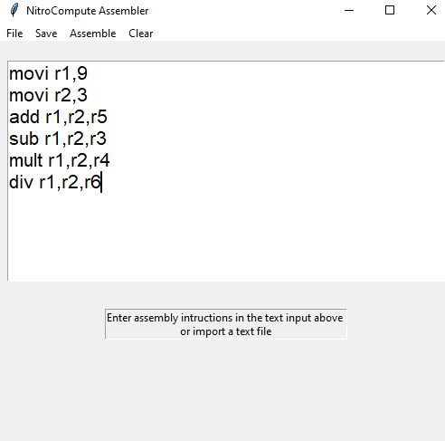
THE ASSEMBLER

Slide 15
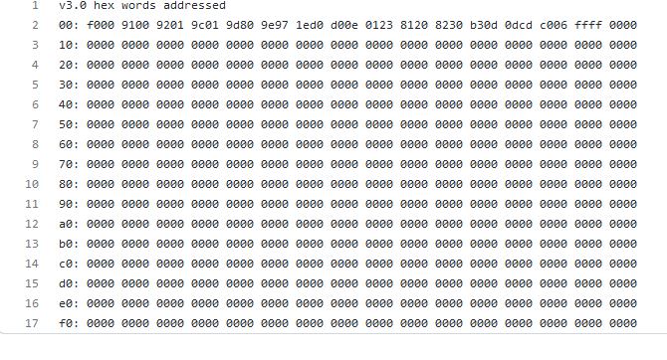
FIBONNACCI PROGRAM

Slide 16
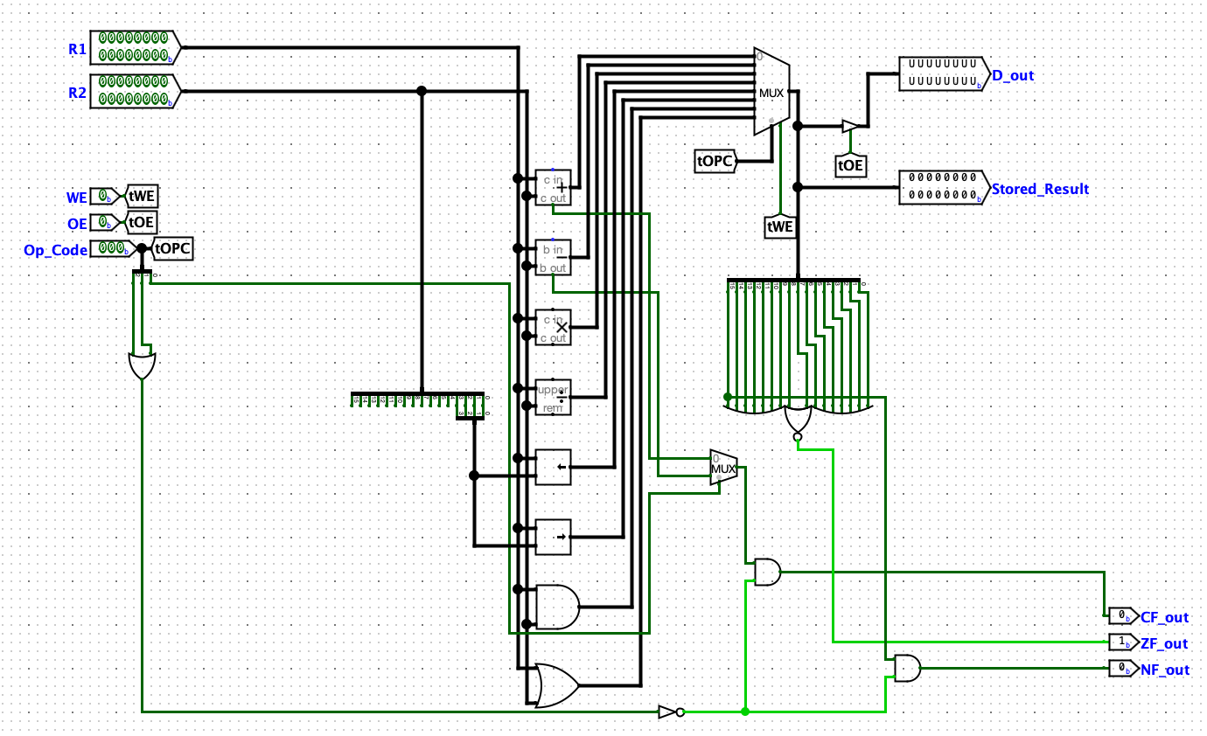
ARITHMETIC AND LOGIC UNIT

Slide 17
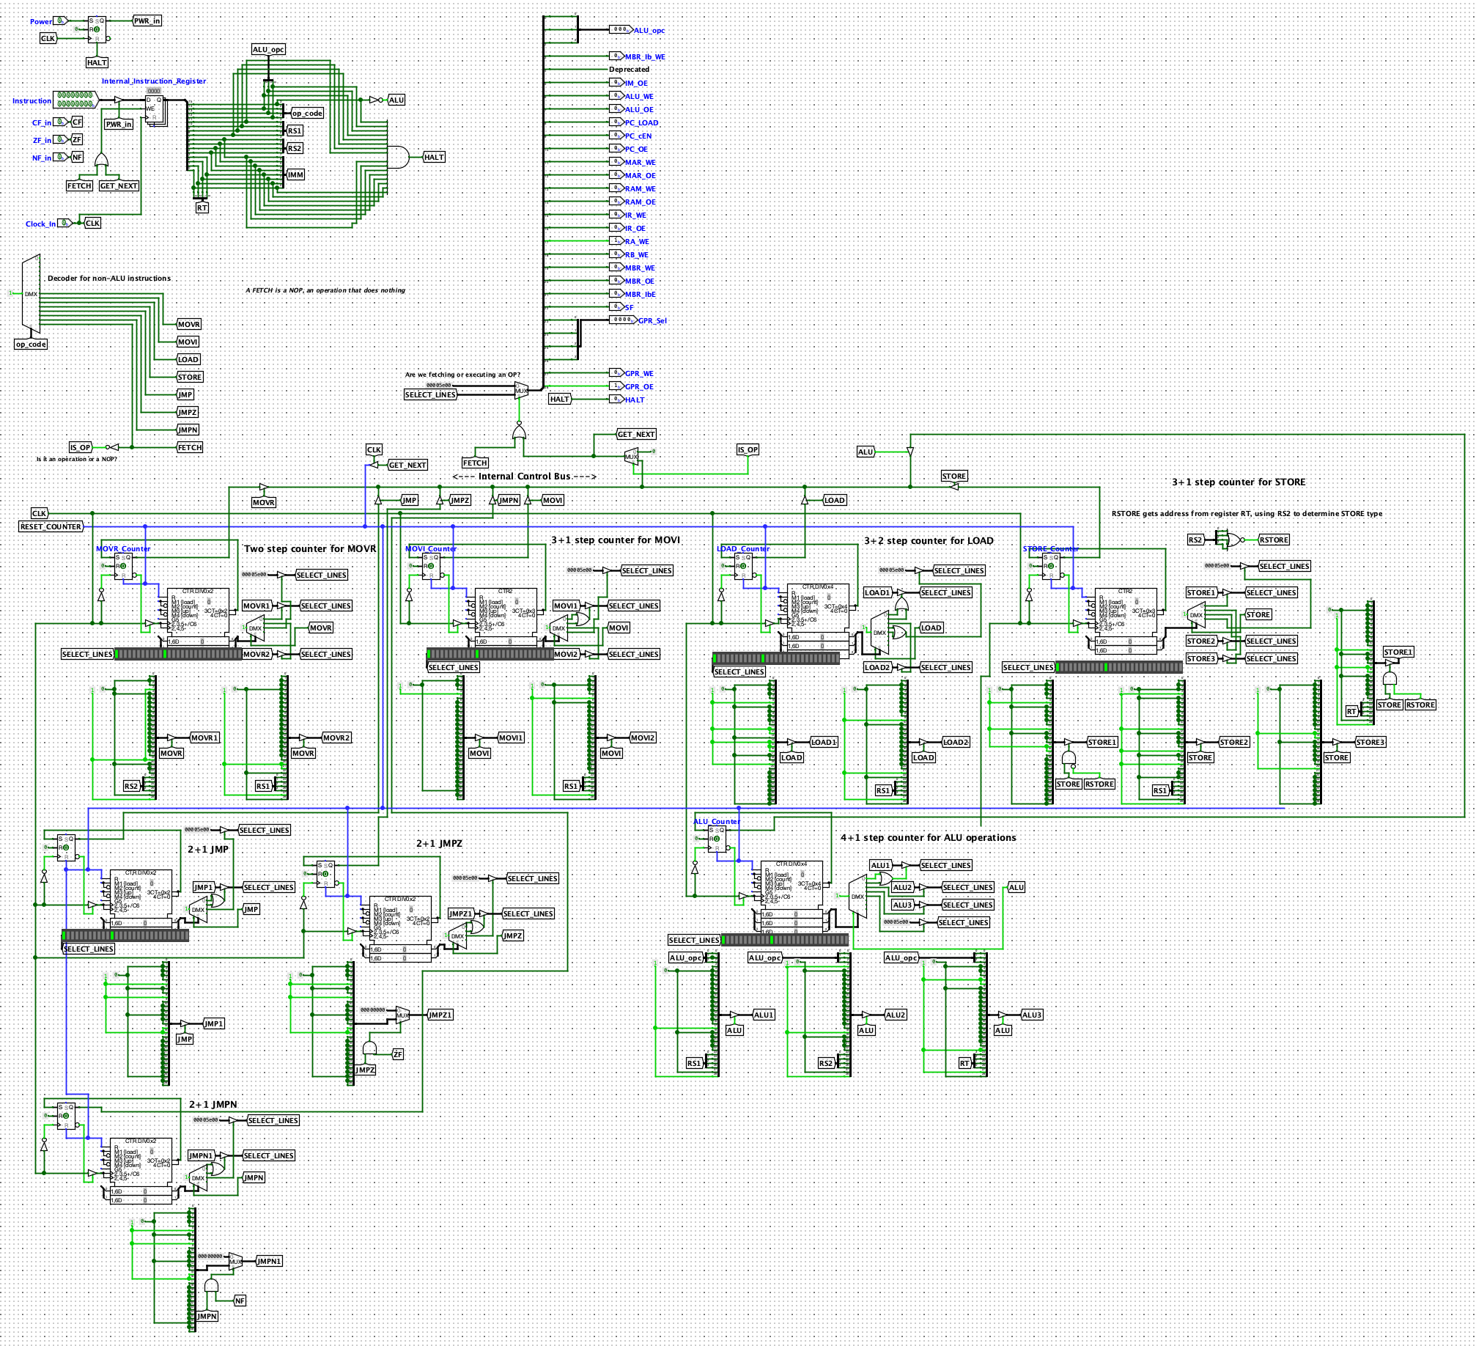
CONTROL UNIT

Slide 18
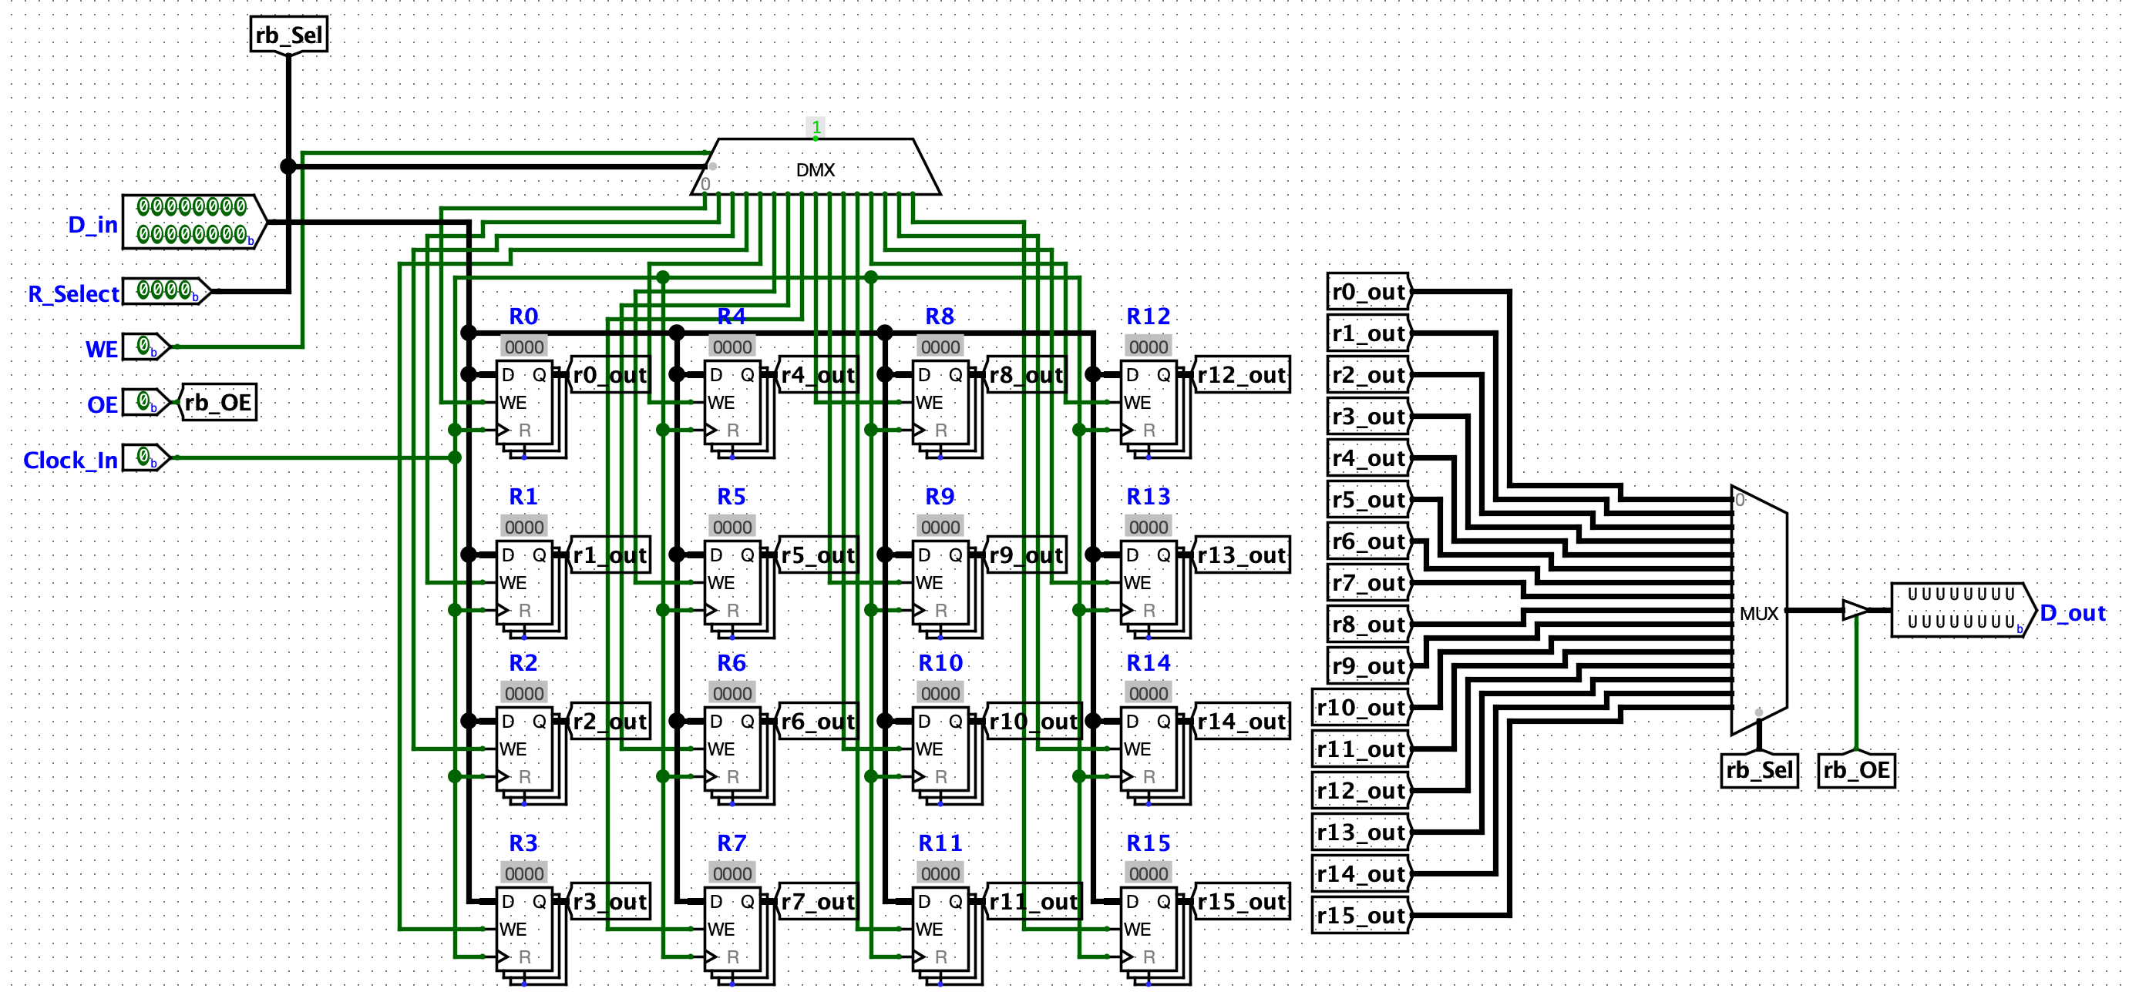
GENERAL PURPOSE REGISTERS

Slide 19
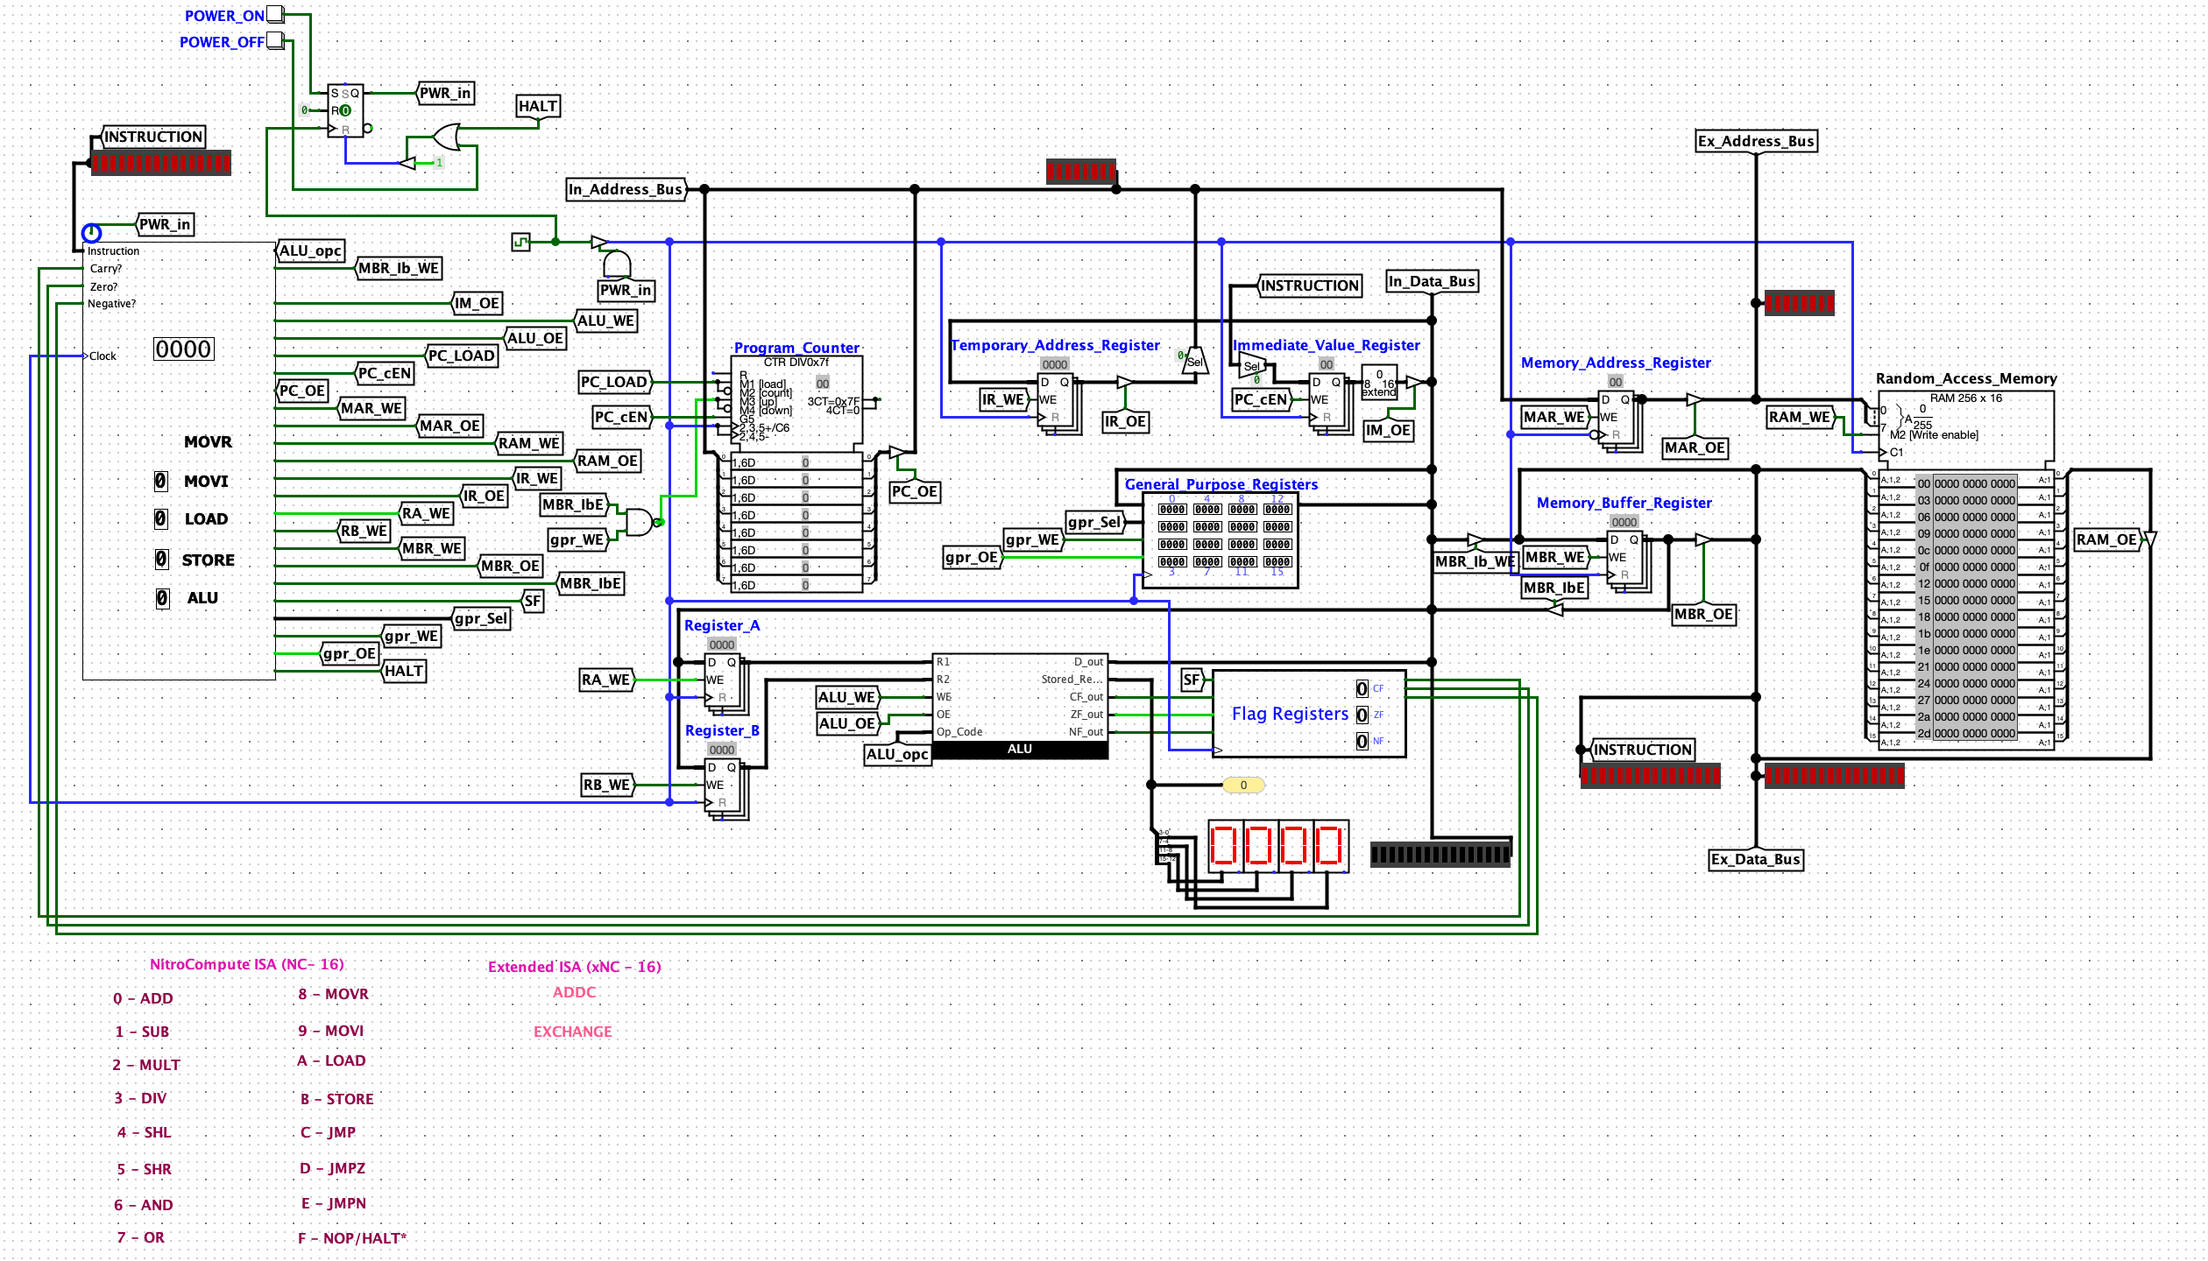
CENTRAL PROCESSING UNIT

